Slide 1

RISK PARITY STRATEGY – Multi-Asset Portfolio

Slide 2
Objective: To build risk optimized multi-asset portfolio based on the risk parity strategy
Correlation Matrix
Assets used:
1) Invesco DWA Healthcare Momentum ETF (PTH) Most recent NAV (Nov 20, 2020) : $146.87 Net Assets: $525.38 Million YTD Return: 53.58% Net Expense Ratio: 0.6% Inception Date: 2006 2) Technology Select Sector SPDR Fund (XLK) Most recent NAV (Nov 20, 2020) : $120.11 Net Assets: $32.68 Billion YTD Return: 32.26% Net Expense Ratio: 0.13% Inception Date: 1998
3) iShares Core U.S. Aggregate Bond ETF (AGG) Most recent NAV (Nov 20, 2020) : $118.29 Net Assets: $81.57 Million YTD Return: 7.24%```` Net Expense Ratio: 0.04% Inception Date: 2003
Asset correlation indicates there is diversification benefit

Slide 3
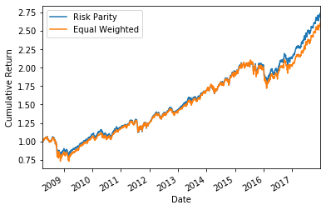
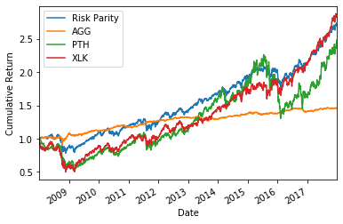
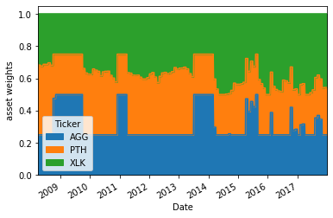
Case 1: Leverage = No, Varmodel = ma, Minimum Weight = 0.25
Under above conditions, Risk parity performs better than equally weighted portfolio as the sharpe ratio of risk optimized portfolio is better than equally weighted portfolio as well as that of individual assets.
Weights are optimized such that portfolio return is close to that of XLK but with risk much lower than XLK and other constituent assets. During stress periods, weights on AGG increases.

Slide 4
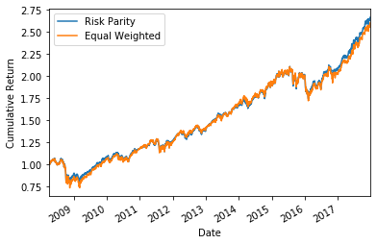
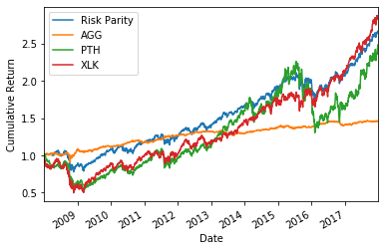
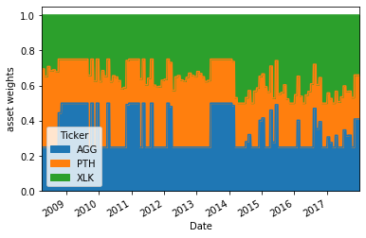
Case 2: Leverage = No, Varmodel = EWma, Minimum Weight = 0.25
Compared with ma variance model, exponential weighted moving average model did not add any value instead sharpe ratio fell marginally.
When we play with minimum weight and increase and decrase the minimum weight, there is no improvement in the sharpe ratio.
We can conclude that EWMA is usefull when we want to capture significant short term fluctuations that may exist in the assets.

Slide 5
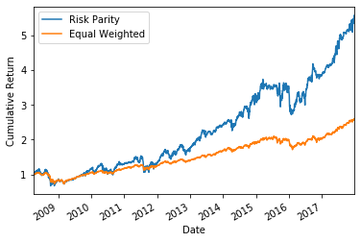
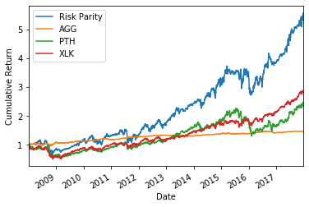
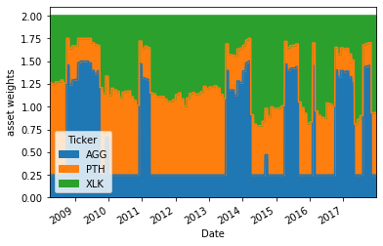
Case 3: Leverage = yes, Varmodel = ma, Minimum Weight = 0.25
With the use of leverage, the sum of portfolio weights can stretch upto 200%. The optimizer increases the portfolio return but also increases risk at faster rate, when compared to risk/return characteristics of equal weighted portfolio. This results in decline in the sharpe ratio of risk optimized portfolio when compared to equally weighted portfolio.
With the chosen assets, the leverage did not add value in increasing sharpe ratio. We may have to chose different combination of assets with different return variance to prove the effectiveness of leverage.
Weights fluctuate more in leverage scenario. During high volatility periods, weight on AGG increases.

Slide 6
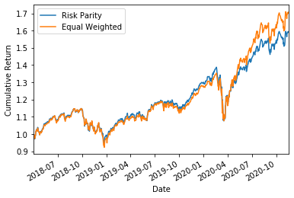
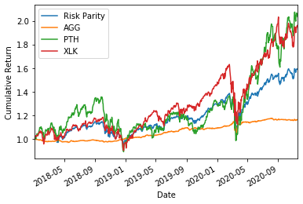
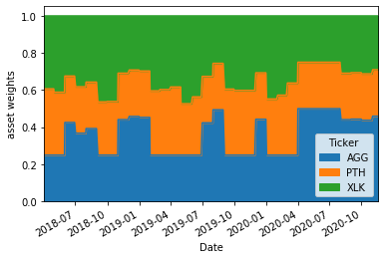
BackTesting Using out of sample data Case 5: Leverage = no, Varmodel = ma, Minimum Weight = 0.25
With model is tested for its effectiveness by using out of sample data.
With short period out of sample data, the the sharpe ratio of both risk parity portfolio and equally weighted portfolio improve compared to in-sample results, which shows risk adjusted return improved.
However, risk parity portfolio sharpe ratio is marginally below to that of equally weighted portfolio.

Slide 7
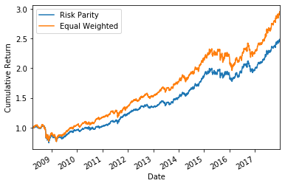
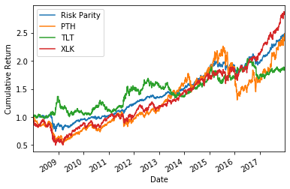
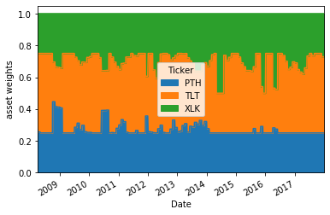
Will low correlation improve the sharpe ratio? Case 7: Leverage = no, Varmodel = ma, Minimum Weight = 0.25
We replace asset AGG with TLT which is another bond ETF that has much lower correlation with rest of the assets compared to AGG.
In no leverage scenario, the addition of low correlation asset did very slightly improve the sharp ratio of risk optimized portfolio while drastically improving the sharpe ratio of equally weighted portfolio.
In leverage scenario, the model as usual pulled the the sharpe ratio down.
When we increased the minimum weight to 0.30, the sharpe ratio of risk parity portfolio improved to 0.89. Asset weights interestingly did not fluctuate over the period.

Slide 8
Observations and conclusion
We found that the risk parity model did well in optimizing the portfolio to increase the sharpe ratio. When tested for the out of sample data, the model’s performance as measured by the sharpe ratio imrpoved. For in-sample data, the risk parity model without assuming the leverage could throw a sharpe ratio of 0.83 which happened to increase to 1.0 for out-of-sample data with no leverage.
However, When we use the leverage, the in-sample data driven risk parity model yields Sharpe ratio of 0.7 while the risk parity model that uses out-of-sample data gives sharpe ratio of 0.66.
As a whole, when leverage is used, the optimization did not work well and sharpe ratio fell. It needs to be further investigated if better optimization techniques can be used such that while returns expand, the risk is still on check which is not the case with the current model.
There was not much of difference in terms of performance when moving average and exponentially moving average models were used. If more risky assets were used, then we could have seen some difference.

